Slide 1
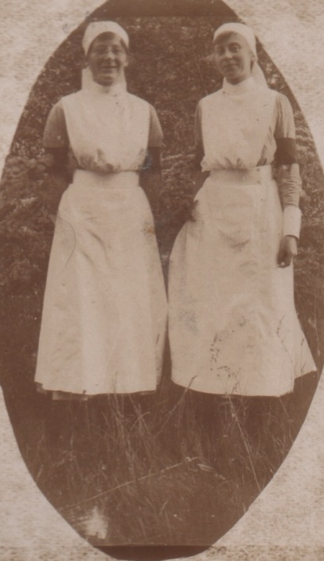
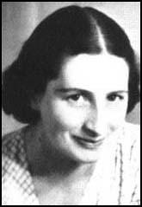
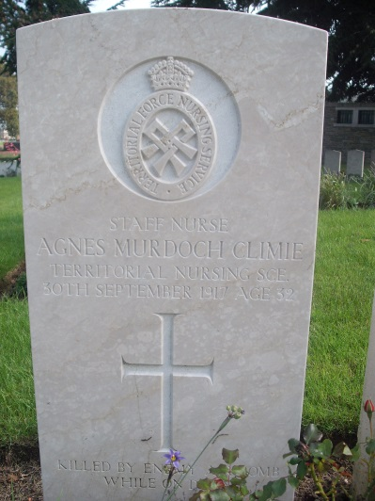
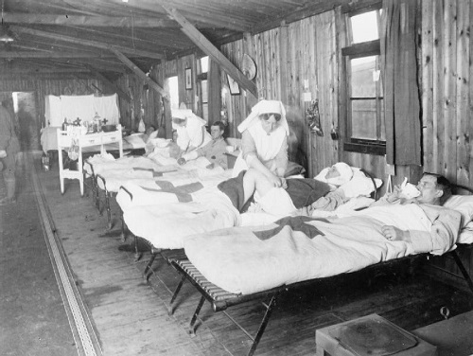
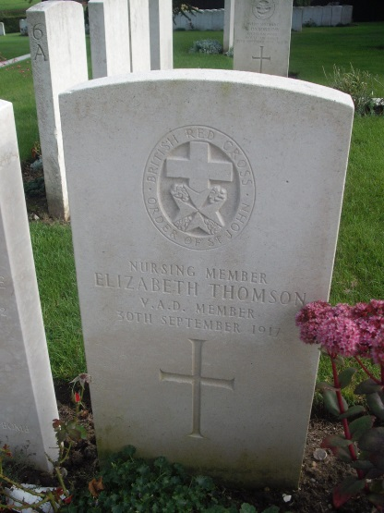
We also served

Slide 2
Vera Brittain
Notes:
Vera was educated at home by a governess and then at a boarding school in Kingswood, where one of the teachers introduced her to the ideas of Dorothea Beale and Emily Davies. Vera wanted to go to university but her father believed that the main role of education was to prepare women for marriage. In 1912 she attended a course of Oxford University extension lectures given by the historian John Marriott. Despite the objections of her father, Brittain set about qualifying herself for admission to one of the recently established women's colleges.

Slide 3
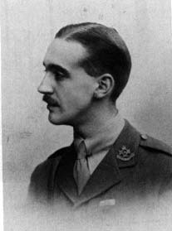
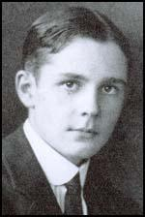
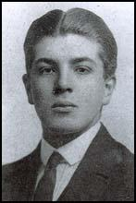
Her brother and friends
Notes:
In 1913, her brother, Edward Brittain, introduced Vera to Roland Leighton, one of his friends from Uppingham School. Leighton, who had just won a place Merton College at Oxford University, encouraged her to go to university and in 1914 her father relented and Vera was allowed to go to Somerville College. He gave her a copy of Olive Schreiner's The Story of an African Farm. Roland told her that the main character, Lyndall, reminded him of her. Vera replied in a letter dated 3rd May 1914: "I think I am a little like Lyndall, and would probably be more so in her circumstances, uncovered by the thin veneer of polite social intercourse." Vera wrote in her diary that "he (Roland) seems even in a short acquaintance to share both my faults and my talents and my ideas in a way that I have never found anyone else to yet."

Slide 4
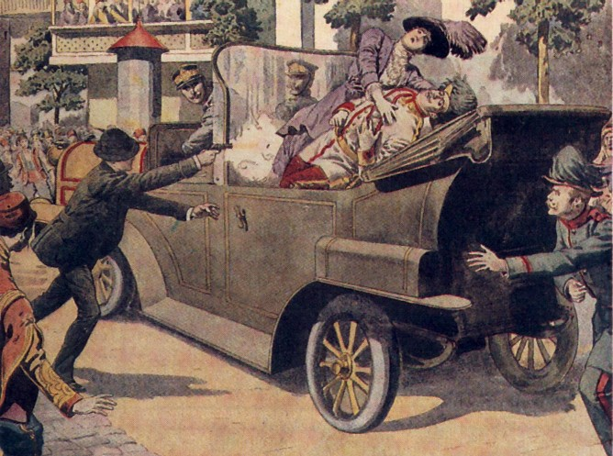
Outbreak of war 4th August 1914

Slide 5
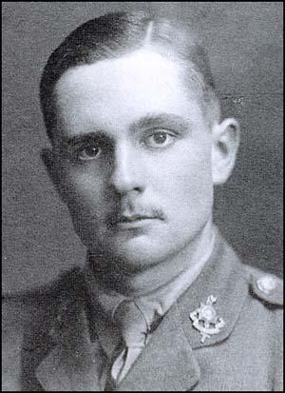
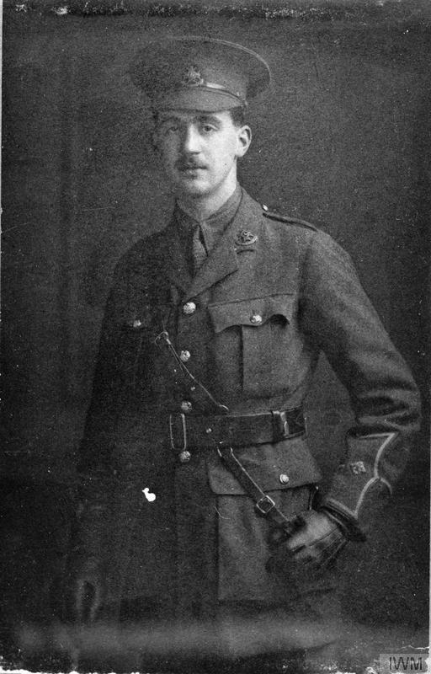
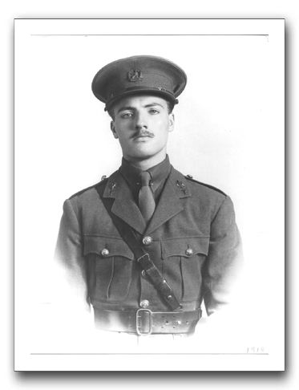
Edward, Roland and Victor
Notes:
On the outbreak of the First World War Roland and Edward, together with their close friend Victor Richardson, immediately applied for commissions in the British Army.

Slide 6
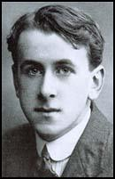
Geoffrey Thurlow
He was educated at Chigwell School where he became Head of School in his final year. His school reported that "he was a boy of the highest sense of duty and remarkable singleness of purpose, and for these qualities, as well as for his tact and his charm of manner, he stands out prominently from among the many excellent Heads of School we have known."

Slide 7
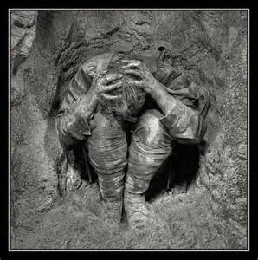
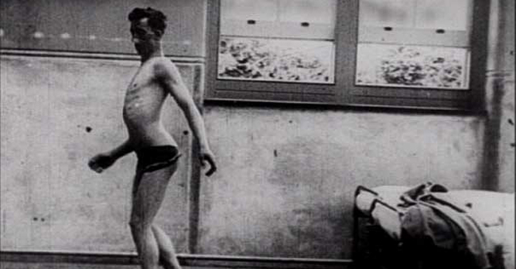
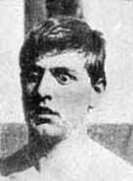
Shellshock

Slide 8
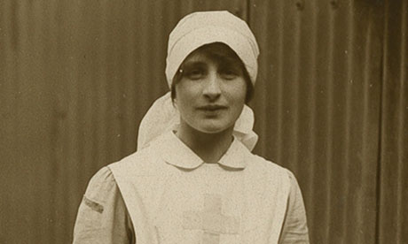
Vera became a nurse
By the end of her first year at Somerville College she decided it was her duty to abandon her academic career to serve her country. During the summer of 1915 she worked at the Devonshire Hospital in Buxton, as a nursing assistant, tending wounded soldiers.
Notes:
By the end of her first year at Somerville College she decided it was her duty to abandon her academic career to serve her country. During the summer of 1915 she worked at the Devonshire Hospital in Buxton, as a nursing assistant, tending wounded soldiers. On 28th June 1915 she wrote to Roland pointing out: "I can honestly say I love nursing, even after only two days. It is surprising how things that would be horrid or dull if one had to do them at home quite cease to be so when one is in hospital. Even dusting a ward is an inspiration. It does not make me half so tired as I thought it would either... The majority of cases are those of people who have got rheumatism resulting from wounds. Very few come straight from the trenches, it is too far, but go to another hospital first. One man in my ward had six operations before coming and is still almost helpless."

Slide 9
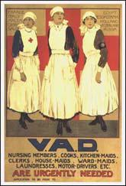
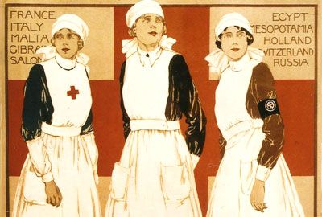
Voluntary Aid Detachment
Notes:
Vera applied to join the Voluntary Aid Detachment (VAD) as a nurse and in November 1915 was posted to the First London General Hospital at Camberwell.

Slide 10
"I have only one wish in life now and that is for the ending of the war. I wonder how much really all you have seen and done has changed you. Personally, after seeing some of the dreadful things I have to see here, I feel I shall never be the same person again, and wonder if, when the war does end, I shall have forgotten how to laugh... One day last week I came away from a really terrible amputation dressing I had been assisting at - it was the first after the operation - with my hands covered with blood and my mind full of a passionate fury at the wickedness of war, and I wished I had never been born."
Notes:
Vera applied to join the Voluntary Aid Detachment (VAD) as a nurse and in November 1915 was posted to the First London General Hospital at Camberwell. Vera found this a traumatic experience. On 7th November 1915 she wrote to Roland Leighton: "I have only one wish in life now and that is for the ending of the war. I wonder how much really all you have seen and done has changed you. Personally, after seeing some of the dreadful things I have to see here, I feel I shall never be the same person again, and wonder if, when the war does end, I shall have forgotten how to laugh... One day last week I came away from a really terrible amputation dressing I had been assisting at - it was the first after the operation - with my hands covered with blood and my mind full of a passionate fury at the wickedness of war, and I wished I had never been born."
She found dealing with the parents of wounded soldiers particularly difficult: "Today is visiting day, and the parents of a boy of 20 who looks and behaves like 16 are coming all the way from South Wales to see him. He has lost one eye, had his head trepanned and has fourteen other wounds, and they haven't seen him since he went to the front. He is the most battered little object you ever saw. I dread watching them see him for the first time."

Slide 11
She found dealing with the parents of wounded soldiers particularly difficult: "Today is visiting day, and the parents of a boy of 20 who looks and behaves like 16 are coming all the way from South Wales to see him. He has lost one eye, had his head trepanned and has fourteen other wounds, and they haven't seen him since he went to the front. He is the most battered little object you ever saw. I dread watching them see him for the first time."

Slide 12
We have heaps of gassed cases at present: there are 10 in this ward alone. I wish those people who write so glibly about this being a holy war, and the orators who talk so much about going on no matter how long the war lasts and what it may mean, could see a case - to say nothing of 10 cases of mustard gas in its early stages - could see the poor things all burnt and blistered all over with great suppurating blisters, with blind eyes - sometimes temporally, some times permanently - all sticky and stuck together, and always fighting for breath, their voices a whisper, saying their throats are closing and they know they are going to choke."

Slide 13
Roland Leighton

Slide 14
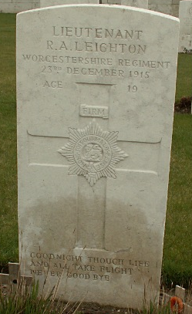
‘Goodnight though life and all take flight’ Never goodbye
Notes:
On the night of 22nd December 1915 he was ordered to repair the barbed wire in front of his trenches. It was a moonlit night with the Germans only a hundred yards away and Roland Leighton was shot by a sniper. His last words were: "They got me in the stomach, and it's bad." He died of his wounds at the military hospital at Louvencourt on 23rd December 1915. He is buried in the military cemetery near Doullens.

Slide 15
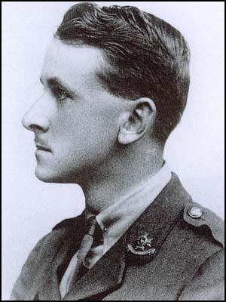
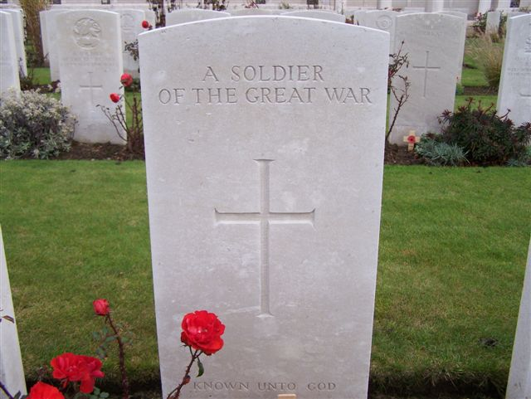
Geoffrey Thurlow
Notes:
Geoffrey Thurlow was killed in action at Monchy-le-Preux on 23rd April 1917. Three days later, Captain J. W. Daniel, wrote to Edward Brittain, about Thurlow's death: "The hun had got us held up and the leading battalions of the Brigade had failed to get their objective. The battalion came up in close support through a very heavy barrage, but managed to get into the trench - of which the Boshe still held a part... I sent a message to Geoffrey to push along the trench and find out if possible what was happening on the right. the trench was in a bad condition and rather congested, so he got out on the top. Unfortunately the Boche snipers were very active and he was soon hit through the lungs. Everything was done to make him as comfortable as possible, but he died lying on a stretcher about fifteen minutes later."

Slide 16
Edward wrote to Vera about Thurlow: "Always a splendid friend with a splendid heart and a man who won't be forgotten by you or me however long or short a time we may live. Dear child, there is no more to say; we have lost almost all there was to lose and what have we gained? Truly as you say has patriotism worn very very threadbare."

Slide 17
Vera decided to return home after the death of Geoffrey Thurlow and the serious injuries suffered by Victor Richardson. She told her brother:"As soon as the cable came saying that Geoffrey was killed, only a few hours after the one saying that Victor was hopelessly blind, I knew I must come home. It will be easier to explain when I see you, also - perhaps - to consult you about something I can't possibly discuss in a letter. Anyone could take my place here, but I know that nobody else could take the place that I could fill just now at home."

Slide 18
Victor Richardson
Notes:
Vera arrived in London on 28th May 1917. The next ten days she spent at Victor's bedside. As Alan Bishop points out: "His mental faculties appeared to be in no way impaired. On 8 June, however, there was a sudden change in his condition. In the middle of the night he experienced a miniature explosion in the head, and subsequently became very distressed and disoriented. By the time his family reached the hospital Victor had become delirious." Victor Richardson died of a cerebral abscess on 9th June, 1917 and is buried in Hove. He was awarded the Military Cross posthumously.

Slide 19
On 3th August 1917, Vera joined a small draft of nurses who were being sent out to the 24th General Hospital at Étaples.
‘’My ward is entirely reserved for the most acute German surgical cases... The majority are more or less dying; never, even at the 1st London during the Somme push, have I seen such dreadful wounds. Consequently they are all too ill to be aggressive, and one forgets that they are the enemy and can only remember that they are suffering human beings."

Slide 20
Edward Brittain
Notes:
In November 1917 Edward Brittain and the 11th Sherwood Foresters were posted to the Italian Front in the Alps above Vicenza. On 15th June, 1918, the Austrian Army launched a surprise attack with a heavy bombardment of the British front-line along the bottom of the San Sisto Ridge. Edward Brittain led his men in a counter-offensive and had regained the lost positions, but soon afterwards, he was shot through the head by a sniper and had died instantaneously.

Slide 21
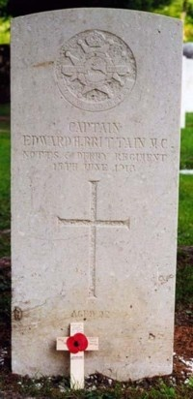

Slide 22
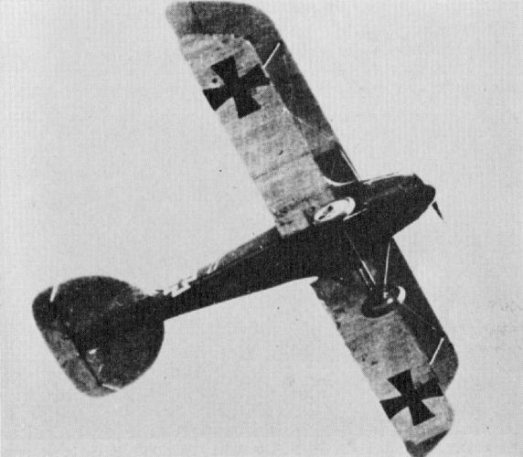

Slide 23
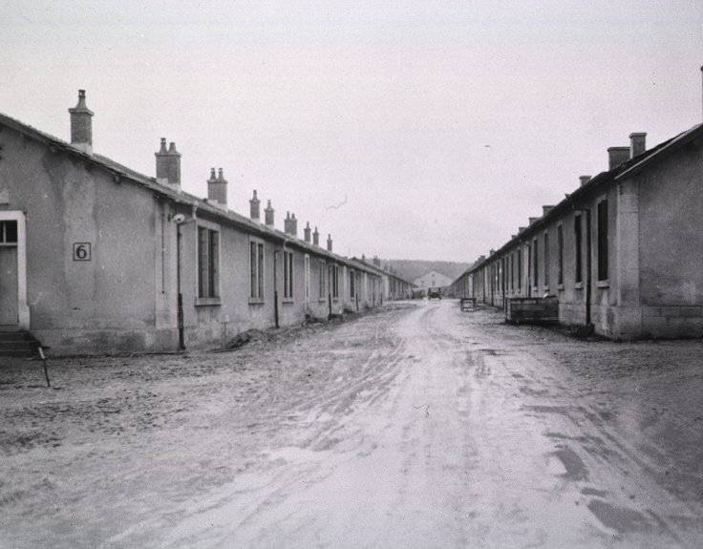
Barracks of the 58th General Hospital, Lerouville France

Slide 24
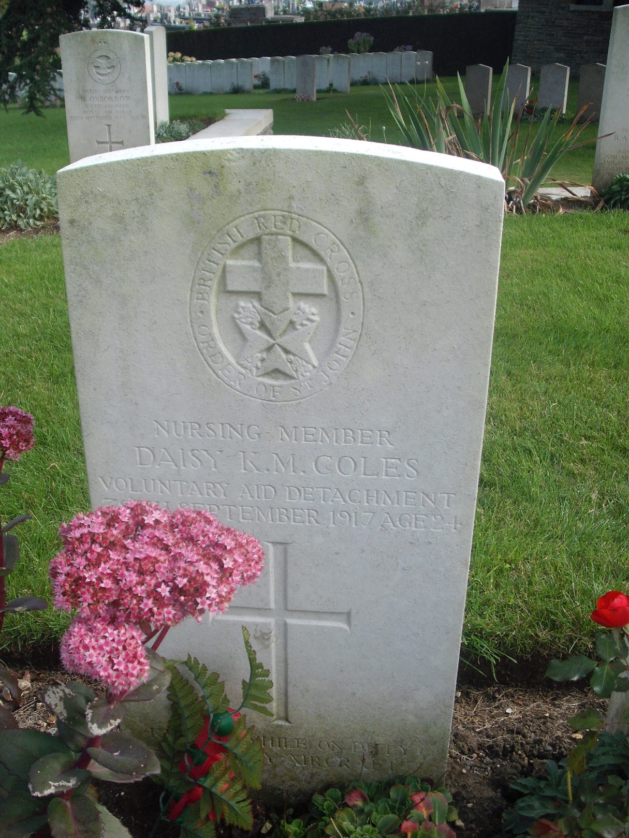
Nursing Member Daisy Kathleen Mary Coles
30/09/1917 Age:24
Voluntary Aid Detachment 58th General Hospital
Daughter of Mr. and Mrs. Walter G. Coles, of Priorsford House, Peebles.

Slide 25
Nursing Member Elizabeth Thomson
30/09/1917
Voluntary Aid Detachment 58th General Hospital

Slide 26
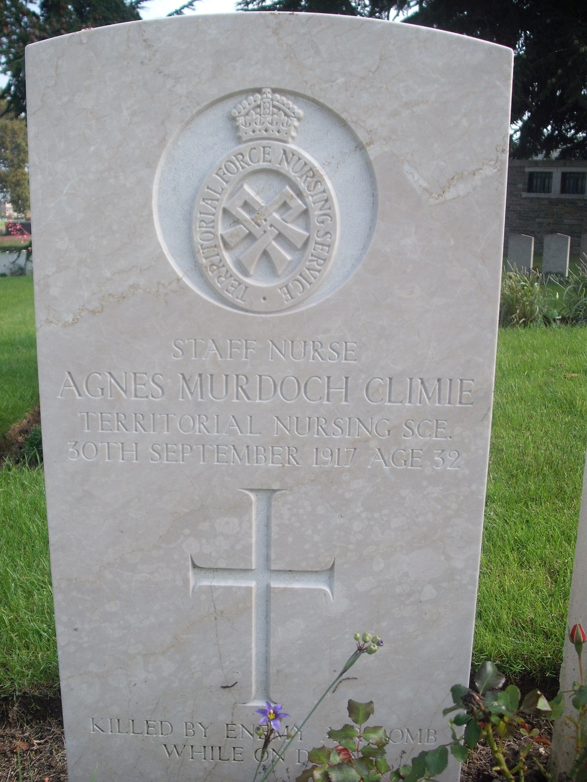
Staff Nurse Agnes Murdoch Climie
30/09/1917 Age:32
Territorial Force Nursing Service 58th General Hospital
Mentioned in Despatches
Daughter of Andrew Climie and Isabella Adam, his wife, of 18, St. Bride's Rd., Newlands, Glasgow.

Slide 27
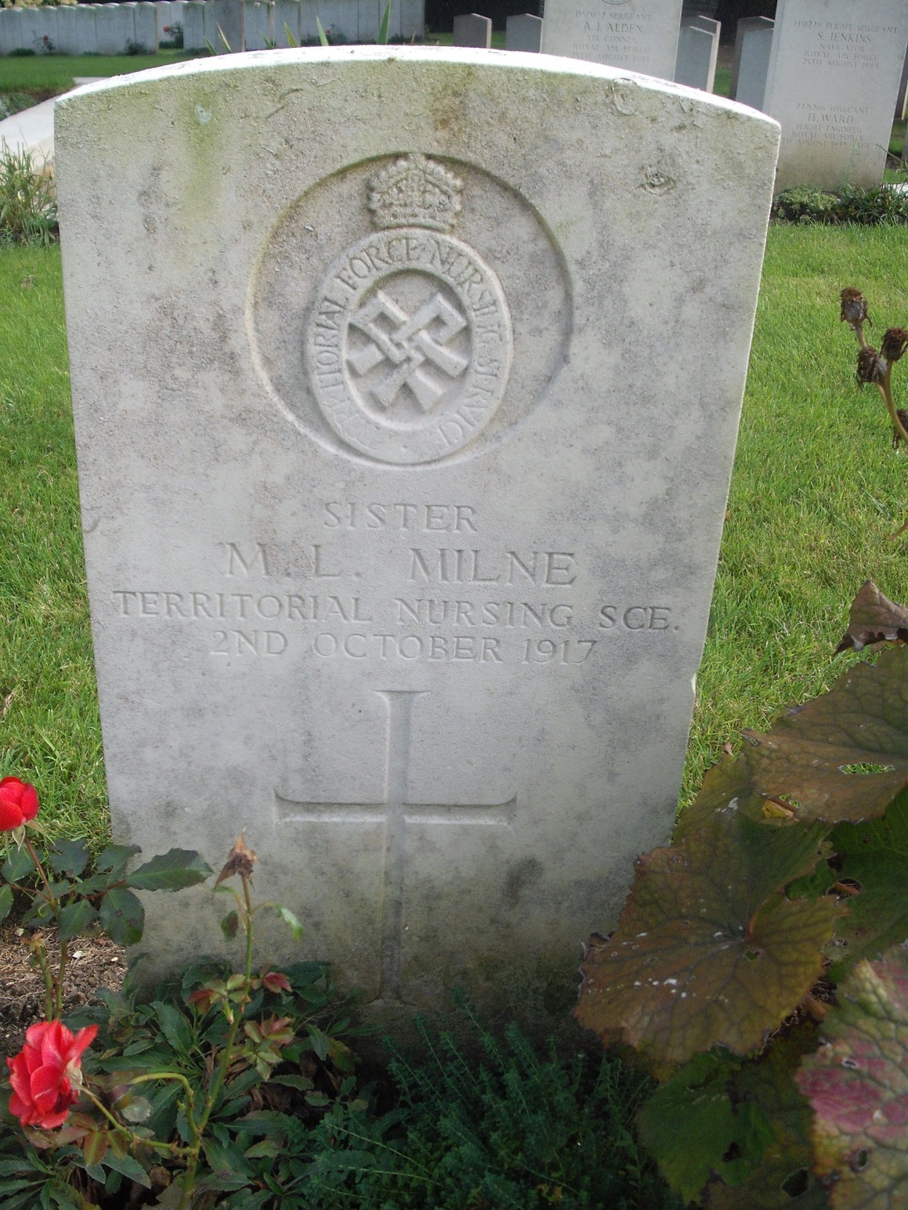
Sister Mable Lee Milne
02/10/1917
Territorial Force Nursing Service 58th General Hospital
Mentioned in Despatches

Slide 28
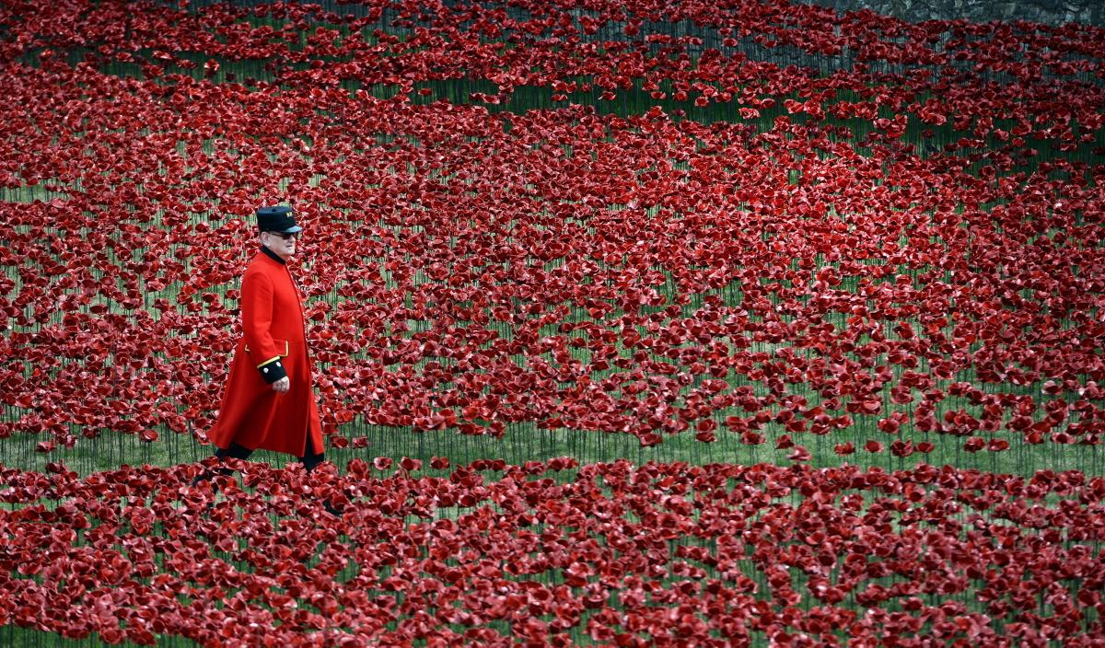
WE WILL REMEMBER THEM

